Slide 1
Advanced Algorithm Assignment 2 Load Balancing Problem
12032189
Yuxi Liu

Slide 2
context
Exercise 1
Exercise 2
Exercise 3

Slide 3
Exercise 1
We assume that there are three machines and ten tasks and each task’s process time is 4.
M1
J1
J4
J7
J10
T1 = 16
M2
T2 = 12
J2
J5
J8
M3
T3 = 12
J3
J6
J9
$T^{∗}$ is always the same as the T1.

Slide 4
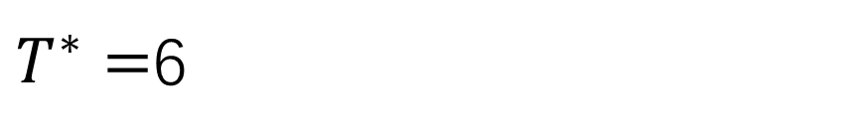
Exercise 2
We assume that there are three machines and seven task with each processing time(2,2,2,2,2,2,6).
In the optimal case, the order of jobs is (6,2,2,2,2,2,2), and the tasks distribution is as follows:
M1
J1
T1 = 6
M2
T2 = 6
J2
J4
J6
M3
T3 = 6
J3
J5
J7
$T^{∗}=$6

Slide 5
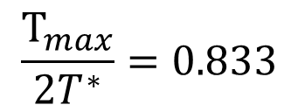

Exercise 2
In normal conditions, such as the order is (2,2,2,2,2,2,6), the tasks distribution will be as follows:
M1
T1 = 10
J1
J4
J7
M2
T2 = 4
J2
J5
M3
T3 = 4
J3
J6
$$\frac{T_{max}}{2T^{∗}}=0.833$$
$$T_{max}=10$$

Slide 6
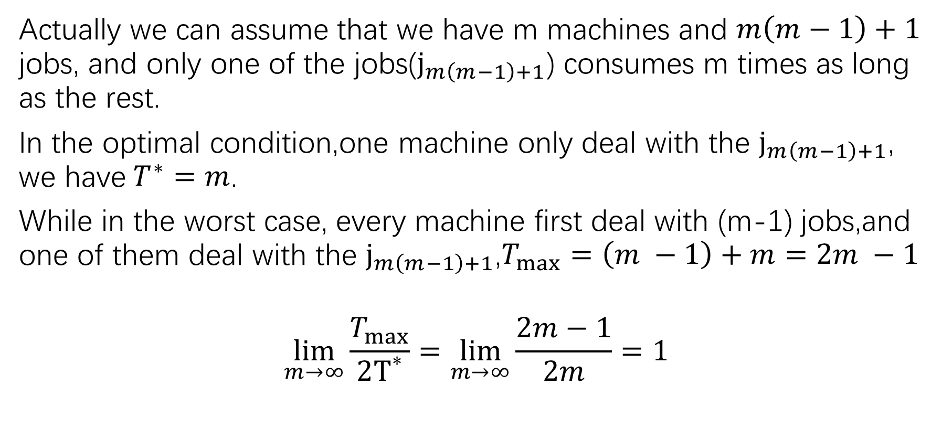
Exercise 2
Actually we can assume that we have m machines and $m\left(m−1\right)+1$ jobs, and only one of the jobs($j_{m\left(m−1\right)+1}$) consumes m times as long as the rest.
In the optimal condition,one machine only deal with the $j_{m\left(m−1\right)+1}$, we have$T^{∗}=m$.
While in the worst case, every machine first deal with (m-1) jobs,and one of them deal with the $j_{m\left(m−1\right)+1}$,$T_{max}=\left(m −1\right)+m=2m −1$
$$\lim_{m→∞}{\frac{T_{max}}{2T^{∗}}}=\lim_{m→∞}{\frac{2m−1}{2m}}=1$$

Slide 7

Exercise 3
Assume that we have three machines and 4 jobs with processing time(8,2,2,2).
In the worst order(2,2,2,8), the machine execution process is as follows:
M1
T1 = 6
J1
J4
M2
T2 = 2
J2
M3
T3 = 2
J3
$$T_{max}=6$$

Slide 8

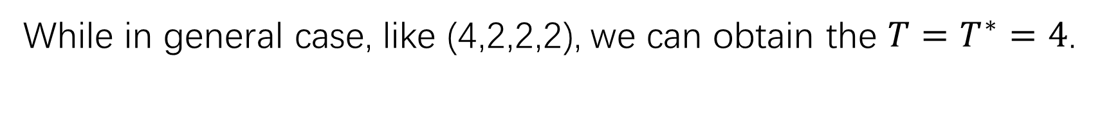
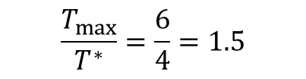
Exercise 3
While in general case, like (4,2,2,2), we can obtain the ${T=T}^{∗}=4$.
M1
T1 = 4
J1
M2
T2 = 2
J2
J4
M3
T3 = 2
J3
$$T_{max}=10$$
In this case, one particular order consumes 1.5 times than general case/
$$\frac{T_{max}}{T^{∗}}=\frac{6}{4}=1.5$$

Slide 9
Thank you

